Slide 1
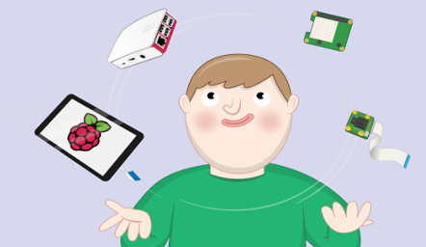
Sensor Data Aggregation and Visualization System

Slide 2

Outline
Requirements
Architecture
Implementation
Testing
Non-functional Requirements
Demo
Notes:
When conducting research, it is easy to go to one source: Wikipedia. However, you need to include a variety of sources in your research. Consider the following sources:
Who can I interview to get more information on the topic?
Is the topic current and will it be relevant to my audience?
What articles, blogs, and magazines may have something related to my topic?
Is there a YouTube video on the topic? If so, what is it about?
What images can I find related to the topic?

Slide 3

Functional Requirements
A development of user-friendly GUI application to aggregate and display the sensor data.
A central communication board that connects the app and the sensors/sensor boards (pico w).
Development of a Customized protocol that facilitates the communication between app and the sensors over different communication channels (1. App-communication board[UART] 2.board-bme680[i2c] 3. Communication Board to senor board(BLE)).
Notes:
After consulting a variety of sources, you will need to narrow your topic. For example, the topic of internet safety is huge, but you could narrow that topic to include internet safety in regards to social media apps that teenagers are using heavily. A topic like that is more specific and will be relevant to your peers. Some questions to think about to help you narrow your topic:
What topics of the research interest me the most?
What topics of the research will interest my audience the most?
What topics will the audience find more engaging? Shocking? Inspiring?

Slide 4
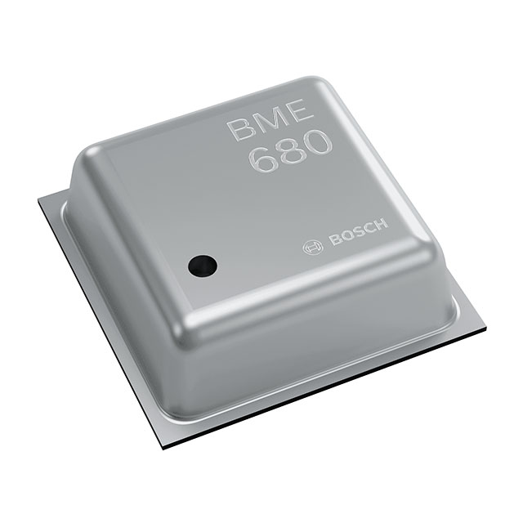
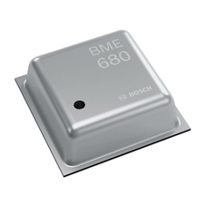



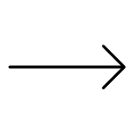



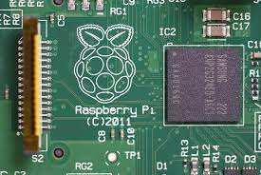
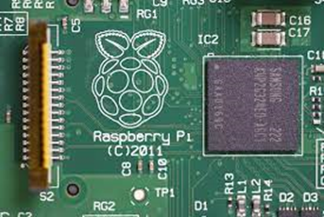
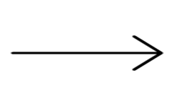
Architecture
I2C
BLE
Customized protocol
GUI APP (SERVER)
serial - Port
CENTRAL PICO
BLE PERIPHERAL PICO
Communication Board
Sensor Board

Slide 5
Contd…
When user requests for a functionality(Clicking button on GUI), the app sends the command(reads) to communication board.
Now the communication board connects & routes the request to respective sensor/sensor board.
And the board fetches the data from the respective sensor and routes a response command back to the user.

Slide 6
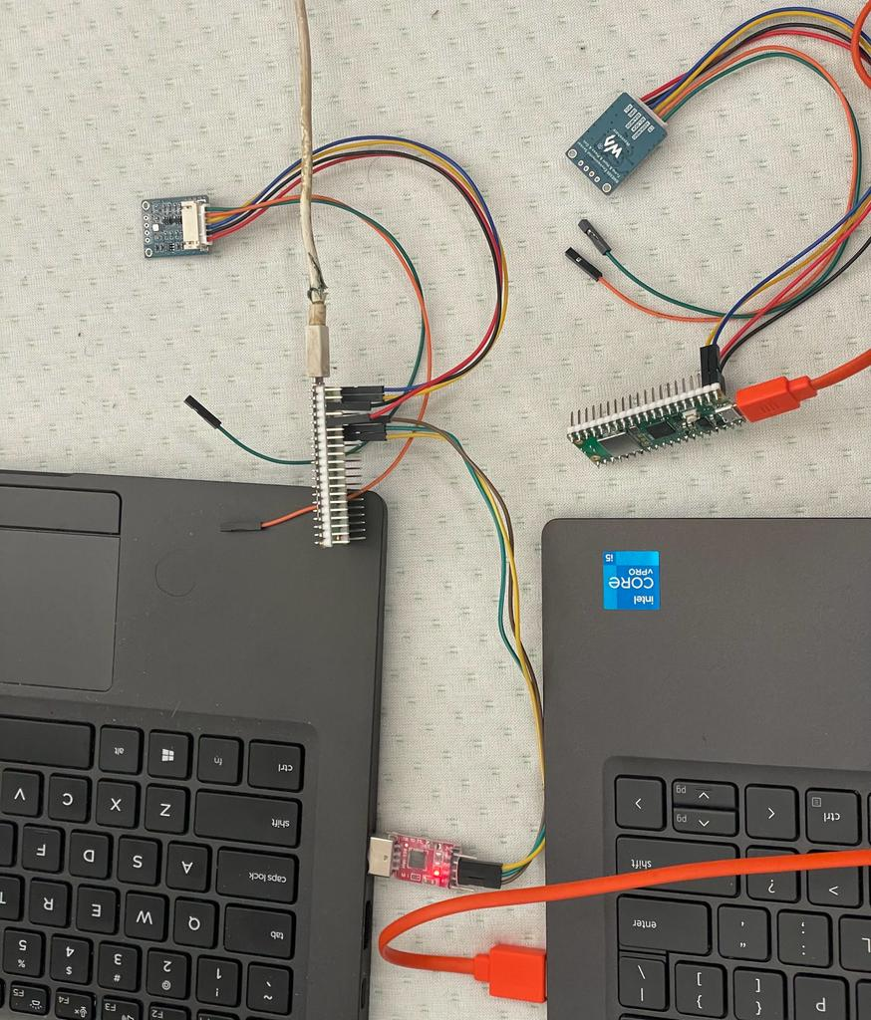
Implementation
A custom protocol was developed for the communication between our app and central communication board.
To ensure Interoperability from the central pico’s perspective between the i2c and BLE connection, An adapter design pattern was used.
Two communication channels were used to connect with the sensors( one BME680 connected over i2c and other over BLE).
This protocol was implemented over serial UART interface.
PyQt5 library was used for developing GUI and matplotlib was used for visualization.

Slide 7



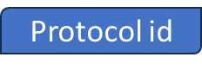
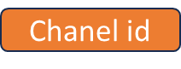
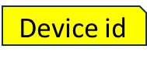
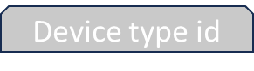

CUSTOM PROTOCOL
Request Structure
Protocol id
Chanel id
Device id
Device type id
Command id
n params
- - - - - - -
Param n-1
Param n
1
2
- - - - - - - - - - - - - - - -
Bytes
- - - - - - - - - - - - - - - -
Response Structure
Command id
n results
- - - - - - -
Unit n
Result n
- - - - - - - - - - - - - - - -
Bytes
- - - - - - - - - - - - - - - -
Notes:
After consulting a variety of sources, you will need to narrow your topic. For example, the topic of internet safety is huge, but you could narrow that topic to include internet safety in regards to social media apps that teenagers are using heavily. A topic like that is more specific and will be relevant to your peers. Some questions to think about to help you narrow your topic:
What topics of the research interest me the most?
What topics of the research will interest my audience the most?
What topics will the audience find more engaging? Shocking? Inspiring?

Slide 8
Constraints
Choice of Communication between the GUI app and Central pico for communication and implementation of custom protocol. A serial UART adapter was chosen as medium of communication for ease of implementation and stability.
Expertise in handling Hardware and coding in respective libraries.
The range and reliability of the UART connection limits the distance between connection board and the sensors, All the boards have to be in limited range of distance.

Slide 9
Testing
Hardware Testing:
Initially, Serial UART connection between laptop and communication board was tested using putty.
Basic sensor connections and readings with the communication board were tested in Thonny by executing basic scripts.
Software Testing:
Testing of custom protocol data frames over serial.read(), and serial.write() methods.
Unit testing of the processing functions for min, max and timeseries.
Unit Testing of BLE and i2c communication from the communication board(central pico)
Integration testing of all components that are connected together.
Challenge:
Replication of sensor lags delays while developing GUI.(Overcame by sleep() methods).

Slide 10
Non-Functional Requirements
Interoperability: The usage of custom protocol and adapter pattern allows for sensors over different communication channels to plug in to the communication board.
Flexibility: The custom protocol was designed in away that it allows for future extensibility of devices and incorporation of wide range of features.
Minimal packet size: Because of the usage of hexadecimal representation and binary encoding. A packet size was maintained without compromising of the features.
Security: Unnecessary data sharing was avoided, only functionally critical data was shared.

Slide 11
Demo

Slide 12
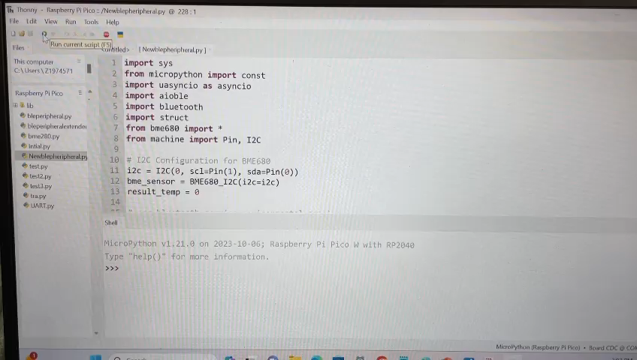

Slide 13

Thank You

